Slide 1

UNIVERSITY OF BASRAH / COLLEGE OF SCIENCE
LECTURE 4
BACTERIAL CLASSIFICATION
Department of Pathological Analyses
Presented by Prof.Dr. Saad S. Mahdi Al-amaradi Al-Amara

Slide 2
Phylum Proteobacteria
Significant groups and genera include:
  The family Enterobacteriaceae, the “Gram-negative enteric bacteria,” which includes genera Escherichia, Proteus, Enterobacter, Klebsiella, Salmonella, Shigella, Serratia, and others
  The family Pseudomonadaceae, which includes genus Pseudomonas and related genera
  Other medically important Proteobacteria include genera Haemophilus, Vibrio, Camphylobacter, Helicobacter, Rickessia, Brucella

Slide 3
  Phylum Firmicutes
  “Low G + C gram-positive” bacteria
  Divided into 3 classes
  ClassI– Clostridia; includes genera Clostridium and Desulfotomaculatum, and others
  Class II – Mollicutes; bacteria in this class cannot make peptidoglycan and lack cell walls; includes genera Mycoplasma, Ureaplasma, and other
  Class III – Bacilli; includes genera Bacillus, Lactobacillus, Streptococcus, Lactococcus, Geobacillus, Enterococcus, Listeria, Staphylococcus, and others

Slide 4
Phylum Actinobacteria
  “High G + C Gram-positive” bacteria
  Includes genera Actinomyces, Streptomyces, Corynebacterium, Micrococcus, Mycobacterium, Propionibacterium
  Phylum Chlamidiae
  Small phylum containing the genus Chlamydia

Slide 5
Phylum Spirochaetes
  The spirochaetes
  Characterized by flexible, helical cells with a modified outer membrane (the outer sheath) and modified flagella (axial filaments) located within the outer sheath
  Important pathogenic genera include Treponema, Borrelia, and Leptospira
Phylum Bacteroidetes
Includes genera Bacteroides, Flavobacterium, Flexibacter and Cytophyga; Flexibacter and Cytophyga are motile by means of “gliding motility”

Slide 6
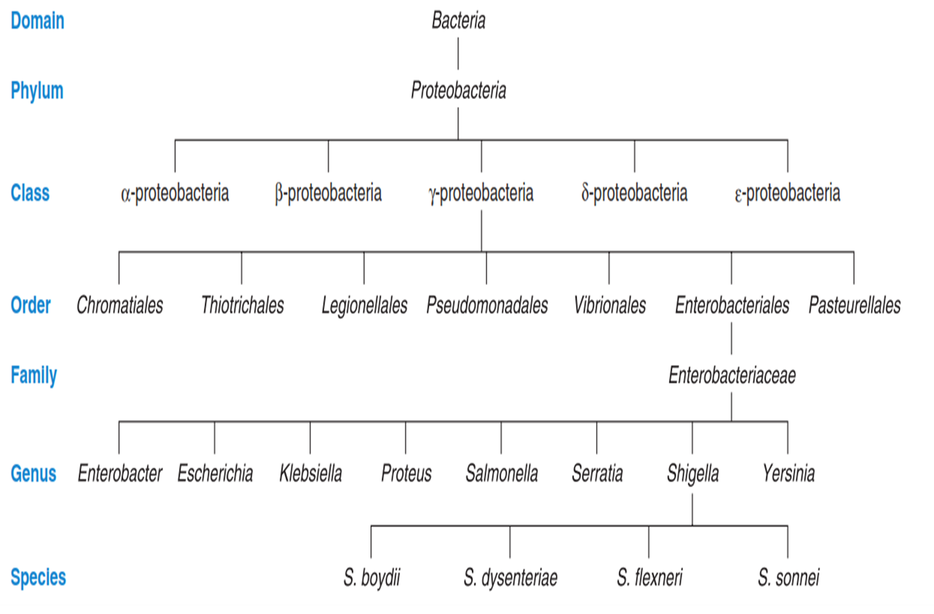

Slide 7
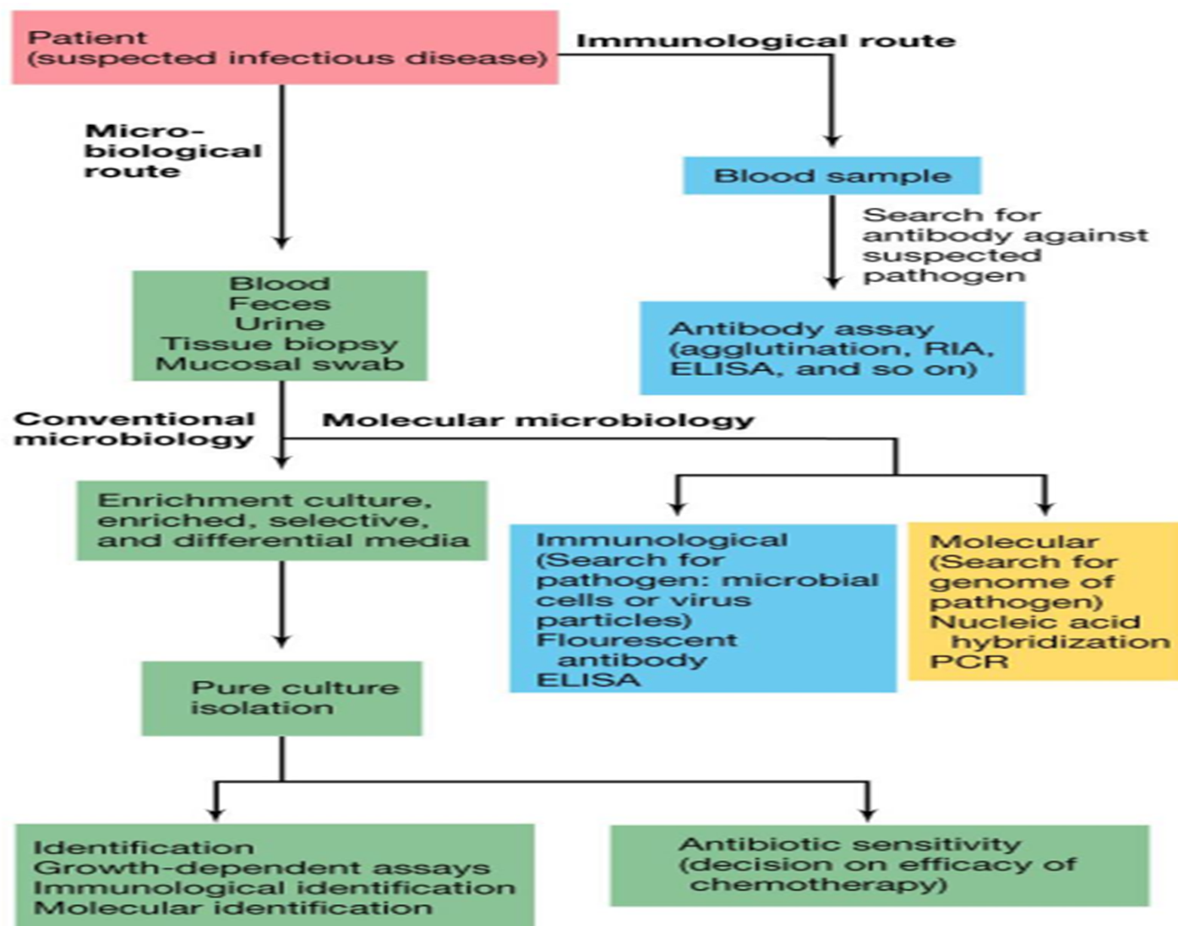

Slide 8



Thank You

